Slide 1
GROUP COACHING CERTIFICATION
MODULE 6: PARTICIPANT SELECTION
GROUP COACHING PRACTICE
Notes:
1

Slide 2
MODULE BREAKDOWN
MODULE 1: You as a Group Coach
MODULE 2: Group Coaching as a Methodology
MODULE 3: Understanding Group Process
MODULE 4: Group Process, Group Facilitation, Group Dynamics & Group Coaching
MODULE 5: Group Coaching Practice Sessions
MODULE 6: Participant Selection in Group Coaching
MODULE 7: ROI – Group Coaching Results and Accountability
MODULE 8: Group Coaching Logistics, Technology & Marketing

Slide 3
MODULE 5: AGENDA-AT-A GLANCE
CHECK – IN
Participant Selection
Group Coaching Practice Sessions
Wrap - Up

Slide 4
Check - In
Share a time when you were in a group of people (any group) and felt uncomfortable.
Describe the situation and surroundings
What did you do and how did you handle it
Did anything make it better or worst?

Slide 5
MODULE 5: Group Process, Group Dynamics and Group Facilitation
WE ARE HERE!

Slide 6
HOMEWORK
OBSERVE GROUPS
LIST 1 AREA THAT YOU ARE CONCERNED ABOUT
PREPARE TO PRACTICE

Slide 7
Participant Selection

Slide 8
Participant Selection Inventory

Slide 9
GROUP COACHING
COACH
In Group Coaching the group is used as a vehicle to accomplish awareness and effectiveness within the individual. The coach acts as a facilitator of the process. This approach can be referred to as a horizontal approach because each individual in the group is at the same level and not inter-connected by the same leader.
PROCESS
Group Member
Group Member
Group Member
Group Member
Group Member
Group Member

Slide 10
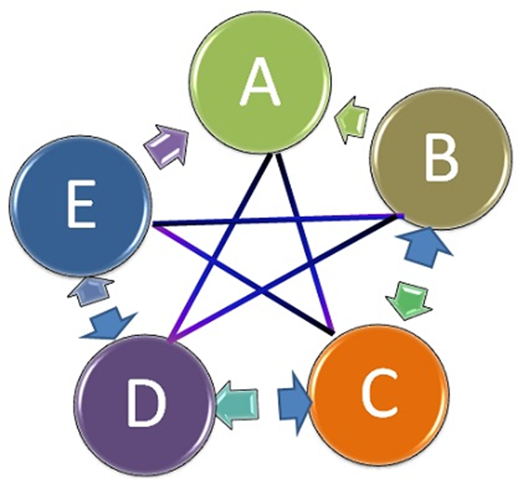
Network Communication Pattern

Slide 11
Importance of Group Composition
Group dynamics is about the interactions that transpire in a group of people
The individuals that make up the group are ley to understanding how the group with function and ultimately how they will bond
Group composition directly impacts the trust and vulnerability levels that will evolve

Slide 12
Group Research Studies
“needs to be of like mindedness” (Participant #5)
“similar focus and commitment” (Participant #18)
“someone I would consider to be a peer” (Participant #11)
“I want to be with people doing what I want to be doing” (Participant #5)
“"Everybody needs to be on the same page working on similar goals. We had some people drop out because they didn't have the same aspirations as everybody else. You have to have the right people in the group.” (Participant #2)
“I felt like I could trust the group very early on in the process and pretty much throughout the group” (Participant #13).

Slide 13
Possible Benchmark
Length of Time | Participants
From the onset of the first meeting | 14%
By the 2nd virtual meeting | 48%
By the 4th virtual meeting | 19%
Did not view the group as a place to share openly | 19%

Slide 14
Counter Indications
Some may not see the group coaching as a place to share intimate details about themselves
20% did not enter into the group coaching process to “get close to other people”
“It was my choice to not share anything personal in the group”
. “I really hesitate to say that I established any form of trust in the group because there is only so deep you can go in a group coaching environment”
“The group never reached that level of intimacy for me, I was there to learn not share.”
What is the Coach’s role in the process?

Slide 15
The Evolution of Sharing
Shared
Goal
Shared Commitment
Vulnerability
Openness
Trust
Level of Sharing
HOW DOES YOUR FIRO-B RESULTS MAP TO THIS EVOLUTION?

Slide 16
Group Coaching Certification Group
Shared goal – learn about group coaching
Shared commitment – Weekly meetings
Trust
Openness
Vulnerability
Level of Sharing
Creation of Agenda
Time

Slide 17
QUESTIONS?

Slide 19
Today’s Group Coaching Agenda
“Unsure how to go about doing this”?

